Slide 1
Use of Dispersants
CGPRT(W) : Ensuring Clean Seas and Coasts in Western Region ……

Slide 2
Objective
To understand the mechanism of dispersion
To understand the tactical advantages and disadvantages of using dispersants
To consider how dispersants can be used as a tactical response option
CGPRT(W) : Ensuring Clean Seas and Coasts in Western Region ……

Slide 3
Introduction
The principal aim of dispersant application is to break up an oil slick for subsequent degradation by naturally occurring micro-organisms
Used appropriately, dispersants can be an effective response to an oil spill and minimize or prevent damage to important sensitive resources
In common with other response techniques, their use must be considered carefully
CGPRT(W) : Ensuring Clean Seas and Coasts in Western Region ……

Slide 4
Introduction
You must take into account:
  The oil characteristics
  The current state of the oil
  Sea and weather conditions, including forecast
  Environmental sensitivities at risk
  National regulations
  The type of dispersant and quantities available
  How you plan to apply dispersants, how you plan to monitor their application and measure their effectiveness
CGPRT(W) : Ensuring Clean Seas and Coasts in Western Region ……

Slide 5
Introduction
In some cases, significant environmental and economic benefits can be achieved through the use of dispersants as a tactical option, particularly when other at-sea response techniques are limited by weather conditions or the availability of resources
Most dispersants are unable to disperse very viscous oils and stable emulsions
CGPRT(W) : Ensuring Clean Seas and Coasts in Western Region ……

Slide 6
Introduction
In summary:
Is it technically reasonable?
Does it meet our NEBA criteria and considerations?
Is it allowed under our regulations?
Do we have the resources?
Can we monitor the effectiveness?
CGPRT(W) : Ensuring Clean Seas and Coasts in Western Region ……

Slide 7
Simple Decision Checklist − Dispersants
Oil Spilled
Yes
No
Continue
Is the oil threatening
sensitive resources
and requires a response?
Continue monitoring
Is containment and
mechanical recovery
practicable?
Is offshore containment
& recovery adequate?
Is the oil amenable
to chemical dispersion?
Do not apply Dispersants
Concentrate effort on protecting
specific coastal resources
Do Not Apply
Is dispersant spraying
environmentally safe?
Apply
CGPRT(W) : Ensuring Clean Seas and Coasts in Western Region ……

Slide 8
Dispersants
Objective: Promote natural dispersion of oil into water column.
Dispersants are chemical products formulated to produce 10s-microns size oil droplets that will be dispersed, diluted and eventually biodegraded in the environment.
New generations of dispersants have low toxicity and high efficiency.
CGPRT(W) : Ensuring Clean Seas and Coasts in Western Region ……

Slide 9
Dispersants
How do dispersants work?
  Chemical formulation to reduce interfacial surface tension between oil and water
  Oil will form 10s-micron size droplets because of mixing energy from waves
  Because of their small size, these droplets will remain suspended in water column as a plume
  Plume will be diluted by mixing energy and currents
  Increase microbial biodegradation due to larger surface area
CGPRT(W) : Ensuring Clean Seas and Coasts in Western Region ……

Slide 10
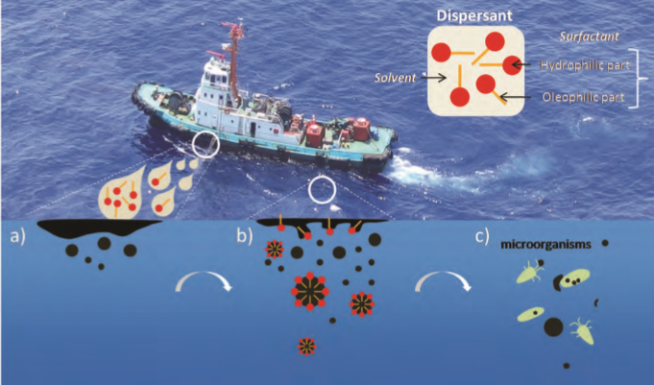
Chemical Dispersion Process
Source: ITOPF TIP 4
CGPRT(W) : Ensuring Clean Seas and Coasts in Western Region ……

Slide 11
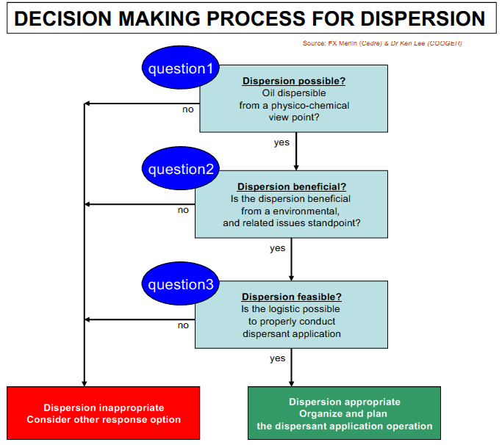
Decision-Making Process
CGPRT(W) : Ensuring Clean Seas and Coasts in Western Region ……

Slide 12
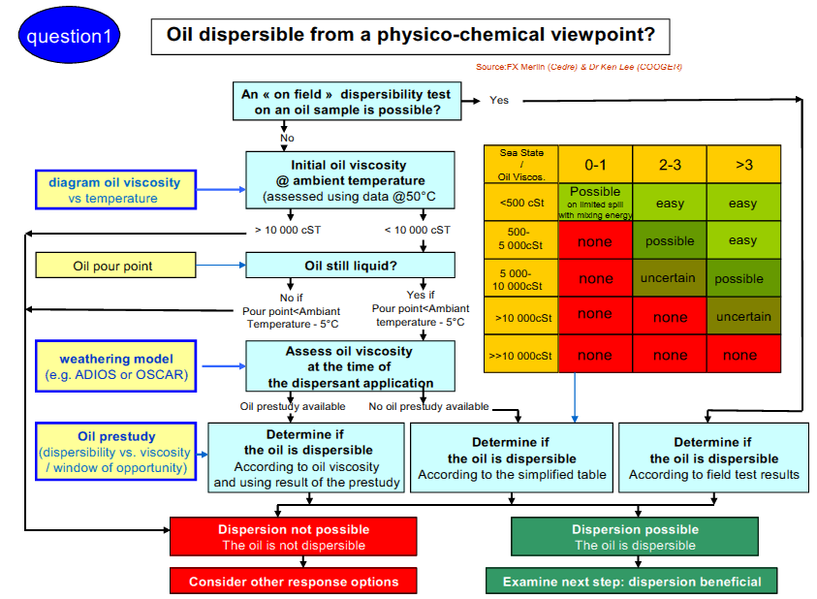
Decision-Making Process – Q1
Source: IMO Dispersant Guidelines – Revised 2014
CGPRT(W) : Ensuring Clean Seas and Coasts in Western Region ……

Slide 13
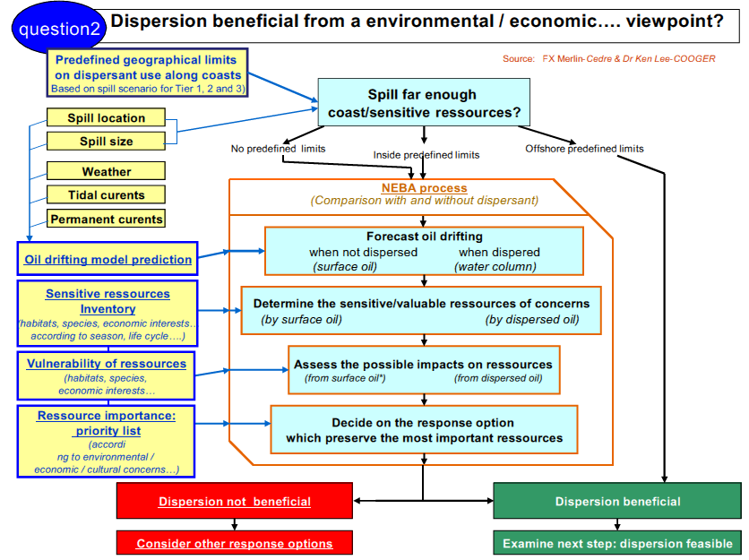
Decision-Making Process – Q2
Source: IMO Dispersant Guidelines – Revised 2014
CGPRT(W) : Ensuring Clean Seas and Coasts in Western Region ……

Slide 14
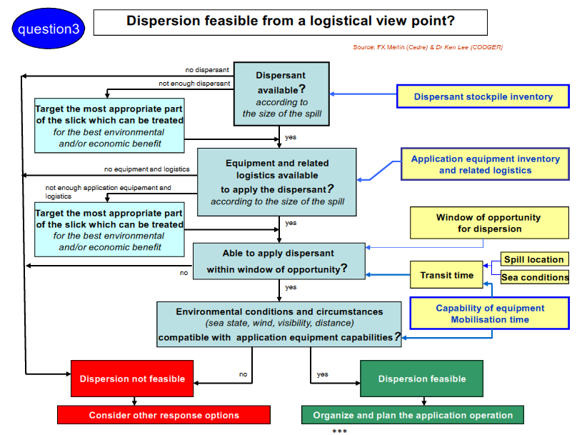
Decision-Making Process – Q3
CGPRT(W) : Ensuring Clean Seas and Coasts in Western Region ……

Slide 15
Dispersants
Application by aircraft or boats
  Aircraft
    Plane
      Longer range
      Higher payload thus wider coverage
    Helicopter
      More targeted
    Trained pilots and operators
    Overhead surveillance and control
  Boats
    Small local response
CGPRT(W) : Ensuring Clean Seas and Coasts in Western Region ……

Slide 16
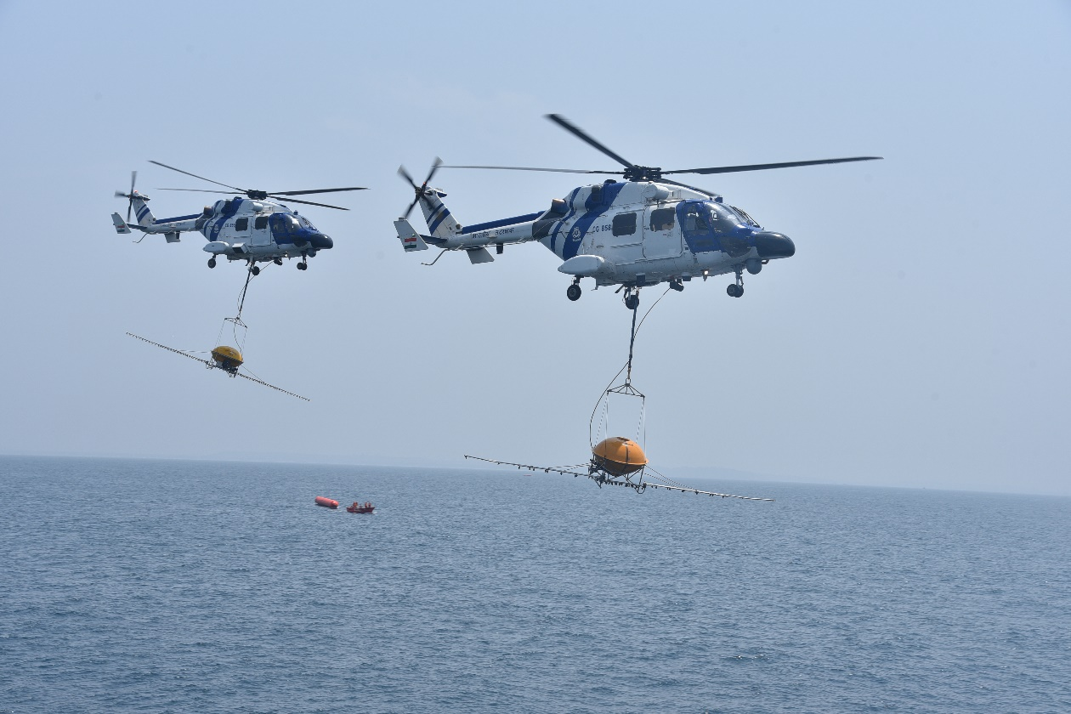
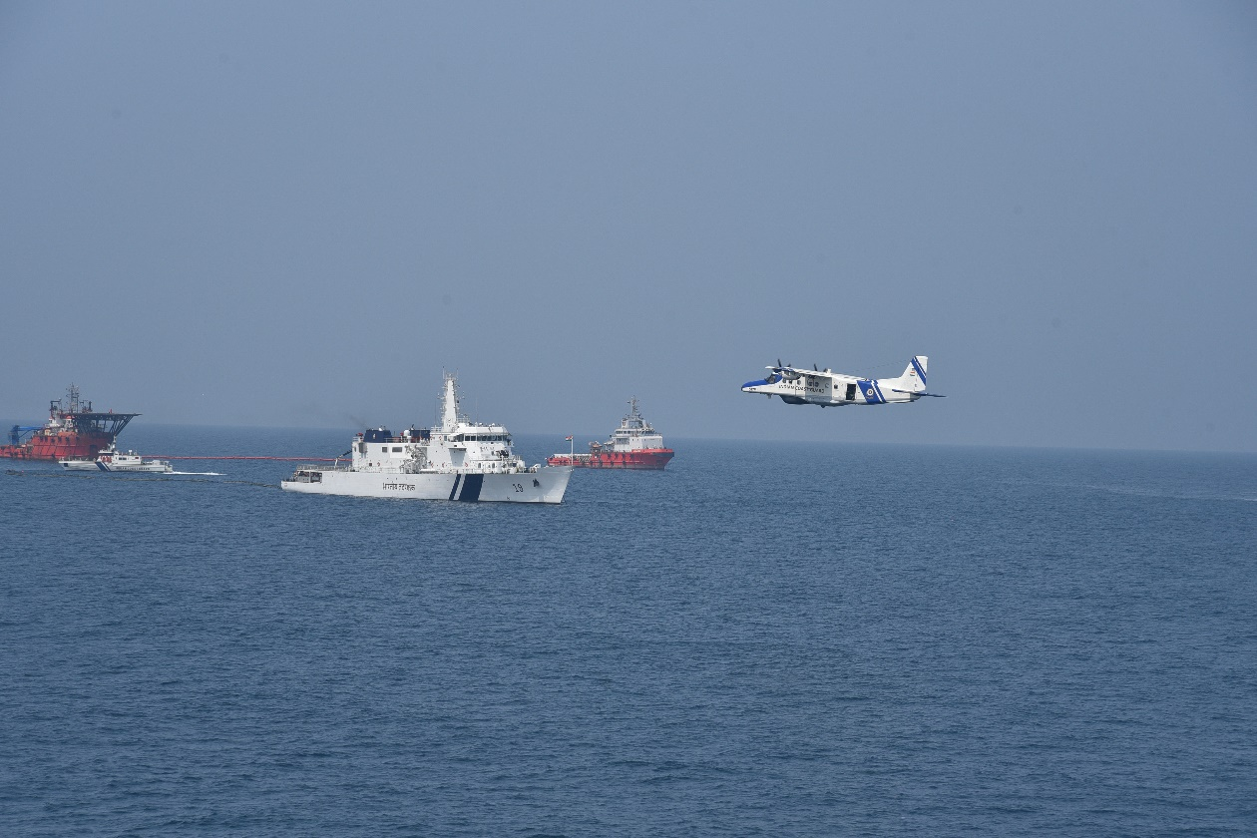
Dispersant application − Aircraft
CGPRT(W) : Ensuring Clean Seas and Coasts in Western Region ……

Slide 17
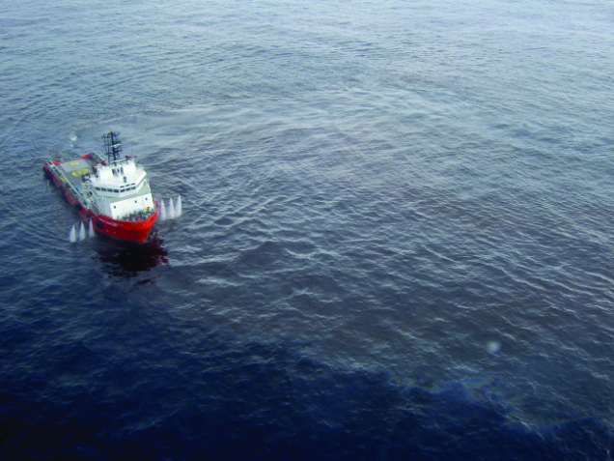
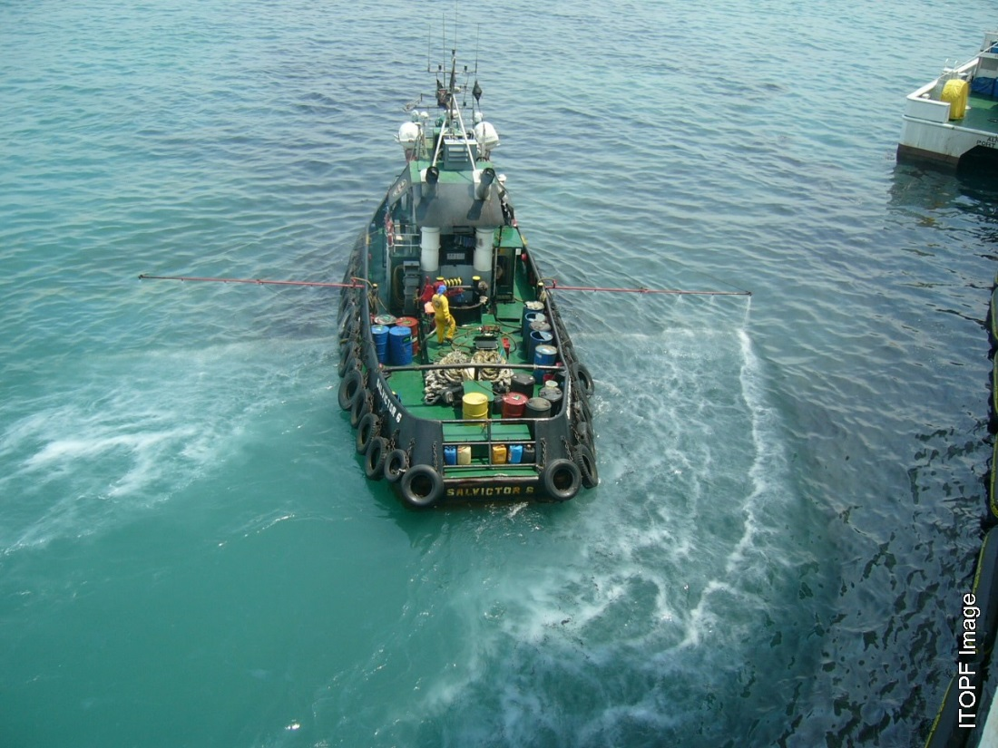
Dispersant Application − Boats
Source: OSRL
Source: ITOPF
CGPRT(W) : Ensuring Clean Seas and Coasts in Western Region ……

Slide 18
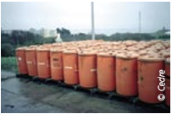
Dispersant
  The application of dispersants requires careful planning, selection, deployment, control and monitoring of resources
  Close cooperation between Operations, Planning and Logistics functions
Command Function
Planning Function
Logistics
Function
Finance Function
Operations Function
Response
Planning
Aerial Surveillance
Aerial Dispersant Operations
Vessel Dispersant Operations
Resource Deployment
Dispersant Monitoring
CGPRT(W) : Ensuring Clean Seas and Coasts in Western Region ……

Slide 19
Dispersants
Issues with dispersants use
  Toxicity
    Dispersants have lower toxicity than dispersed oil
    Field test have shown higher oil concentrations in 0 to 10 m water depth
    Background oil concentration within hours
    Short duration exposure because of dilution
  Oil viscosity and dispersibility
    Readily dispersible for oil viscosity below 5,000cSt
    Moderate for oil viscosity between 5,000 – 10,000cSt
    Likely to be ineffective above 10,000cSt
CGPRT(W) : Ensuring Clean Seas and Coasts in Western Region ……

Slide 20
Dispersants
Issues with dispersants use
  Oil viscosity and time
    Weathering processes will increase oil viscosity over time;
    Dispersants must be applied before viscosity is too high;
    “Window of opportunity”
  Sea state and weather
    Typically requires between 3 to 18 m/s wind speed and 0.5 to 5 m wave height
    Weather conditions must permit application of dispersants
CGPRT(W) : Ensuring Clean Seas and Coasts in Western Region ……

Slide 21
Dispersants
Issues with dispersants use
  Government approval
    Usually required by national regulations with a list of approved dispersants
    Criteria for application and dispersants use policy
    Monitoring protocol to ensure effectiveness
  Application zones
    Not in or near shallow water (less than 10 to 20 m) although use may be justified in shallow water if a specific NEBA case can be made
    Not near water intakes
  Net environmental benefit
CGPRT(W) : Ensuring Clean Seas and Coasts in Western Region ……

Slide 22
Dispersants
Conflict with other response methods
  Coordination of all response methods is necessary to ensure dispersant use does not conflict with other techniques
  Oil dispersed into the water column cannot be contained by booms or recovered by skimmers
  The effectiveness of oleophilic skimmers and sorbent materials can be significantly reduced by the use of dispersants
CGPRT(W) : Ensuring Clean Seas and Coasts in Western Region ……

Slide 23
Dispersants − Monitoring
Ongoing monitoring of effectiveness should be undertaken
Visual observation of effectiveness may be impaired by:
  Poor weather, high sediment waters, pale-coloured oils, poor light
Effectiveness can be monitored by towing an ultra-violet fluorometer below the oil to measure the variation in oil concentrations
Should be used with visual observations
CGPRT(W) : Ensuring Clean Seas and Coasts in Western Region ……

Slide 24
Dispersants
Advantages
  Elimination of oil from sea surface
    Protection of birds and sensitive shorelines e.g. mangroves
  High encounter rate (higher than other options)
  Wide range of weather conditions
  Enhances biodegradation of oil
  Does not generate waste
  Quick response (if in contingency plan)
  Reduces potentially harmful vapours; a safety benefit
CGPRT(W) : Ensuring Clean Seas and Coasts in Western Region ……

Slide 25
Dispersants
Disadvantages
  Dispersed oil plumes may cause damage to sensitive resources such as coral, shellfish beds or industrial water intakes
  For most crude oils (and some fuel oils) only a brief opportunity exists in which dispersants will be effective
  Most dispersants are unable to disperse very viscous oils and stable emulsions
  Dispersants can deteriorate over time, according to their properties and storage conditions
CGPRT(W) : Ensuring Clean Seas and Coasts in Western Region ……

Slide 26
Any questions?
CGPRT(W) : Ensuring Clean Seas and Coasts in Western Region ……

